Slide 1



FOOD ORDERING MANAGEMENT SYSTEM
Presented by :
SATYAM KUMAR PHY202302EF10

Slide 2
Agenda / Contents
PROBLEM STATEMENTS
NEW INVENTION
ALGORITHM
FLOWCHART
PSEUDO CODE
SOFTWARE USED
APPLICATION USED

Slide 3
Problem Statement
Nowadays, many restaurant using traditional restaurant ordering system to serve customers. In the traditional restaurant ordering system, the staff write down the foods that the customer order.
The paper will then pass to the kitchen and the chef will start to cook. This has caused few inconveniences. The staff might make some errors while writing down the order.

Slide 4
New Inventions

Slide 5
Algorithm
START the program.
Display the main menu with options for the user to choose from(e.g., BreakFast,Lunch,Dinner exit).
If the user selects”Lunch”prompt the user will be asked to enter the number, he/she what to select food item.
machine will ask user to enter the quantity,using function.
rate is predefined which will be multiplied with the quantity
AT LAST
final price of the food item ordered will be printed.

Slide 6
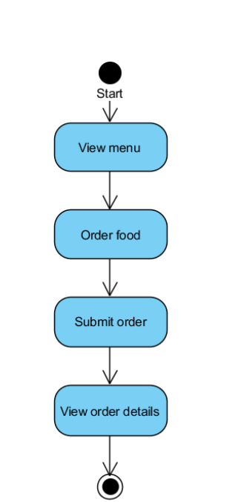
Flowchart
Start
printf("");
printf("");
printf("");
printf("");
printf("");
printf("");
printf("");
printf("");
printf("");
printf("");
printf("");
printf("");
scanf("");
case 1
T
printf("");
B?
B?
B?
B?
B?
F
case 2
T
printf("");
B?
B?
B?
B?
B?
F
T
case 3
printf("");
B?
B?
B?
B?
B?
F
T
default
F
printf("");
Stop

Slide 7
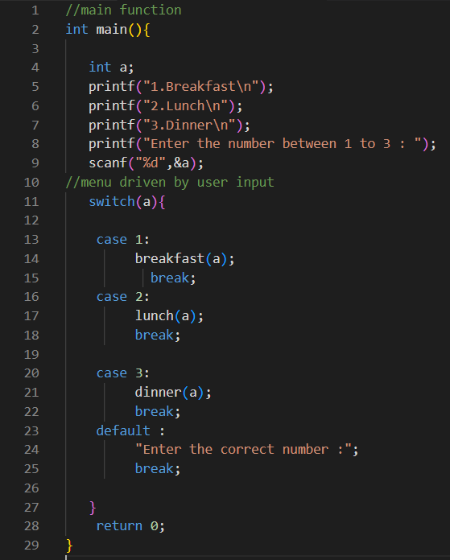
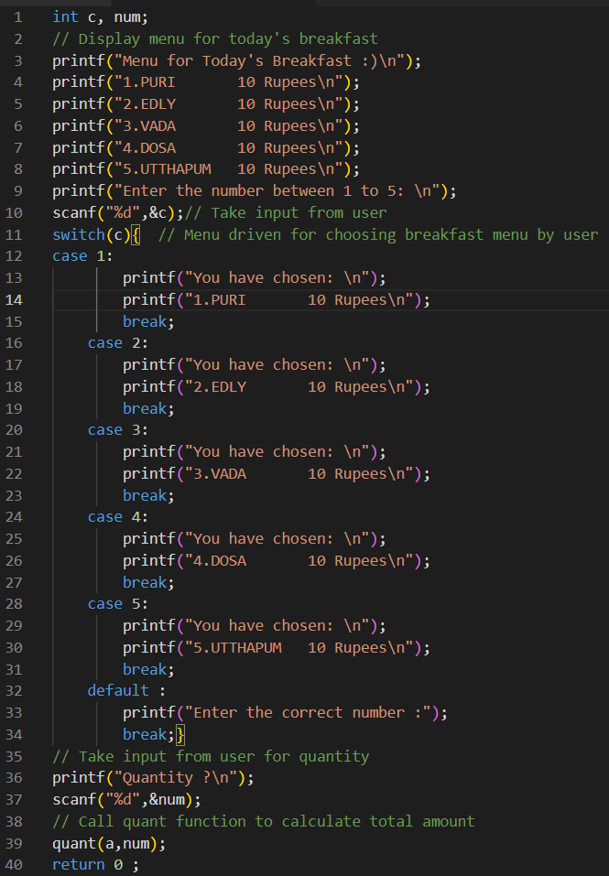
Pseudo Code

Slide 8
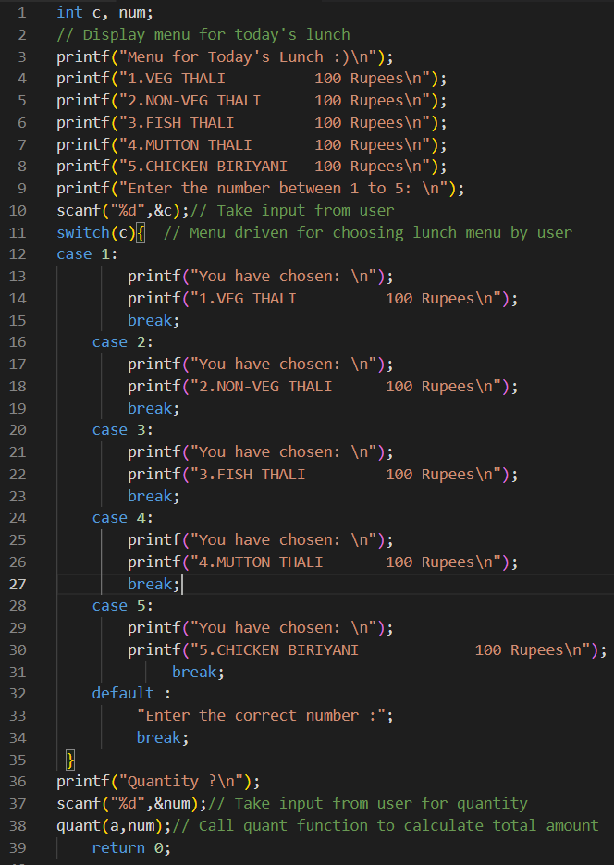
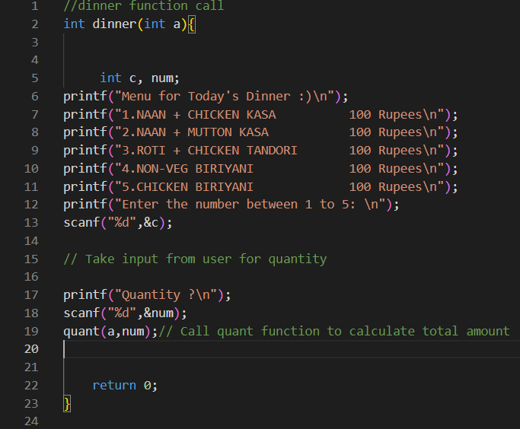
Pseudo Code

Slide 9

Software Used
VS CODE PLATFORM VERSION 1.76

Slide 10
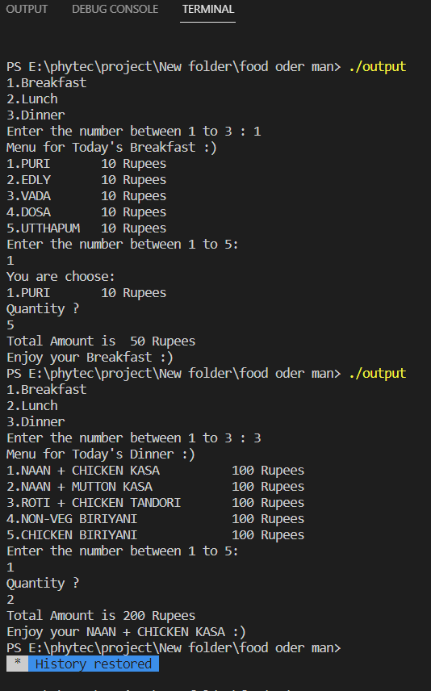
Application Result

Slide 11

Thank You

